Slide 1

Happy Customer Bank
Credit Card Lead Prediction

Slide 2
INDUSTRY TREND
Credit Cards are usually allotted based on Age Profile
Credit Profile of Customer
Salary , Account Balance
Age of Customer in Bank
Transactional History

Slide 3
Approach
A brief on the approach, which you have used to solve the problem
What data-preprocessing / feature engineering ideas really worked? How did you discover them?
What does your final model look like? How did you reach it?

Slide 4
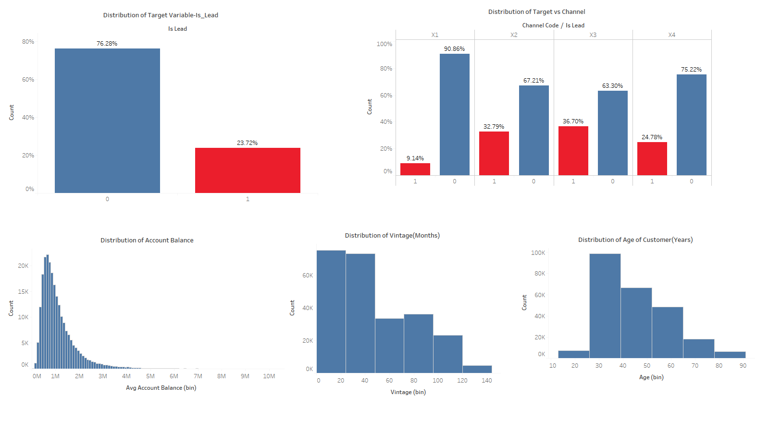
Exploratory Data Analysis
Is_Lead
23.72% conversions
Channel
X2,X3
Continuous Variables
Right skewed Account _Balance

Slide 5
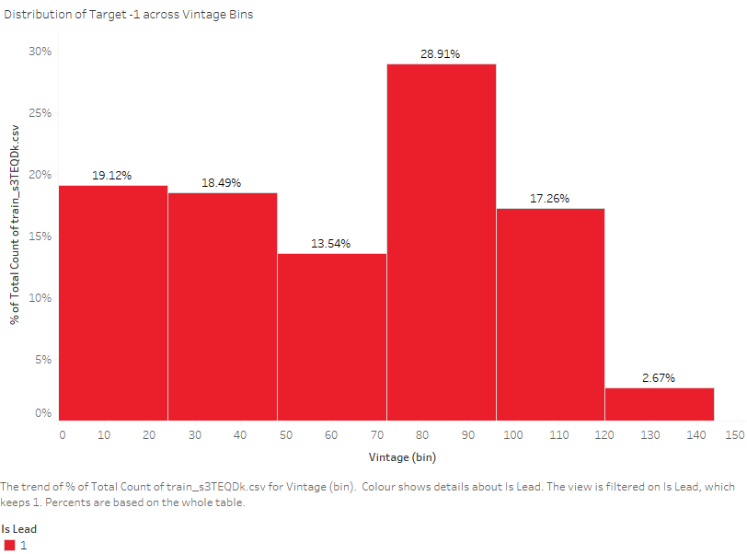
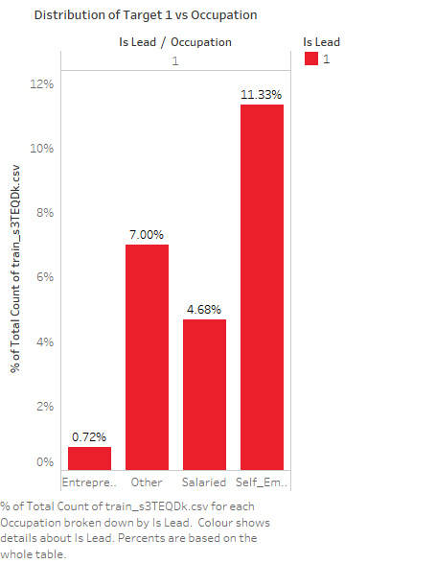
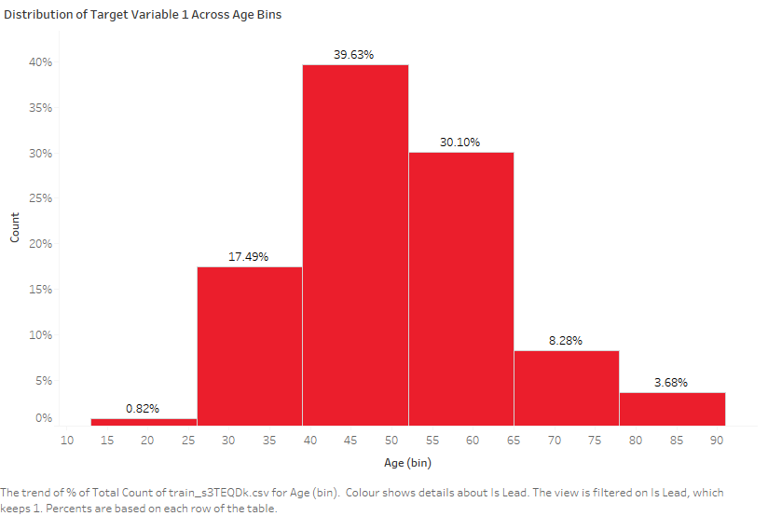
Target 1 Distribution
Age Bins
Max conversions from Age-Bins 40-60
Vintage Bins
Max conversions from Vintage Bins 46% from 6-8 years,32% from 0-4years
Occupation
Max Conversions from Occupation Self Employed

Slide 6
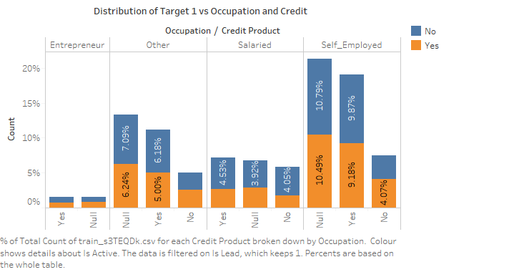
Target 1 vs Occupation|Credit
Occupation and Credit have a higher impact
Building Interaction Features might help

Slide 7
Pre-Processing
Min-Max Scaler of Age, Vintage , Account Balance
Label Encoding of Categorical variables
Frequency Encoding of interaction features since distribution of data across categorical features is captured
Reducing levels of Region – Top > 5000 were identified and grouped

Slide 8
Feature Engineering
Total of 138 features were built
Dropped ID
Aggregate Features of interaction features – min, max,mean,sum ,standard deviation of all features
. Final shape
Train Predictors-(245725, 137)
Test Predictors-(105312,137)

Slide 9
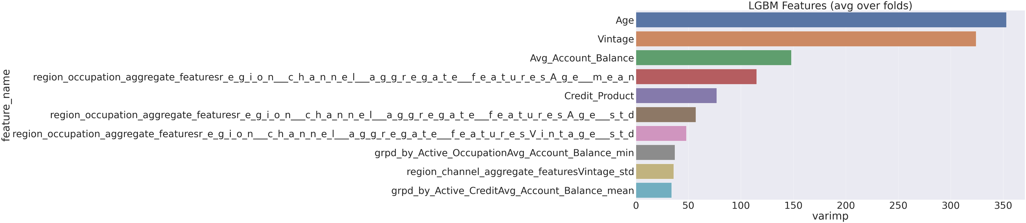
Models Used-LGBM
Average Stratified-KFold Score : 0.874109277726837

Slide 10
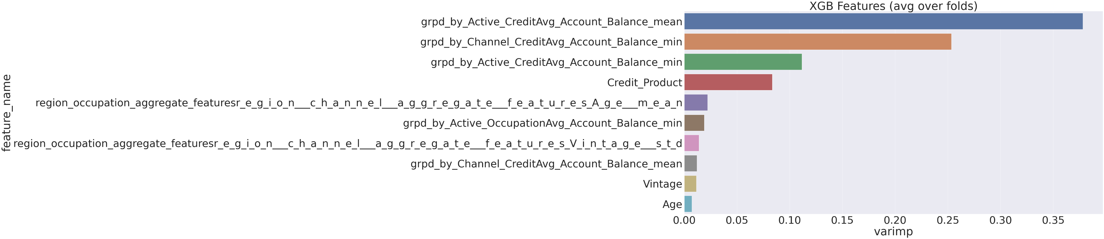
Models Used-XGBM
Average StratifiedKFold Score : 0.8731464590413118

Slide 11
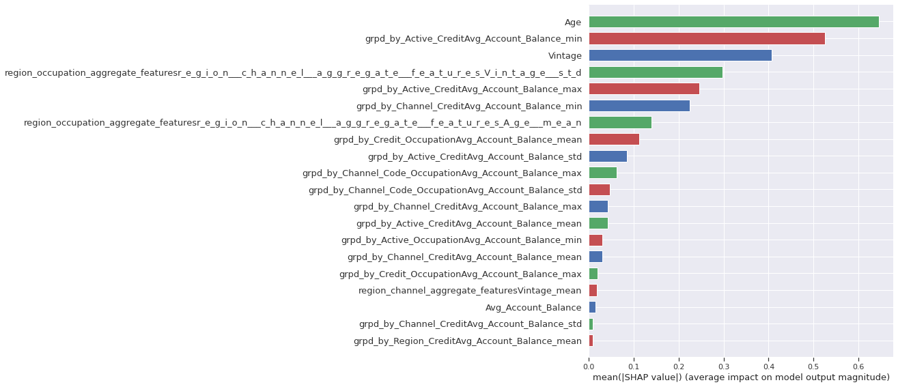
Models Used-CatBoost
Average Stratified-KFold Score : 0.8736018320655713

Slide 12
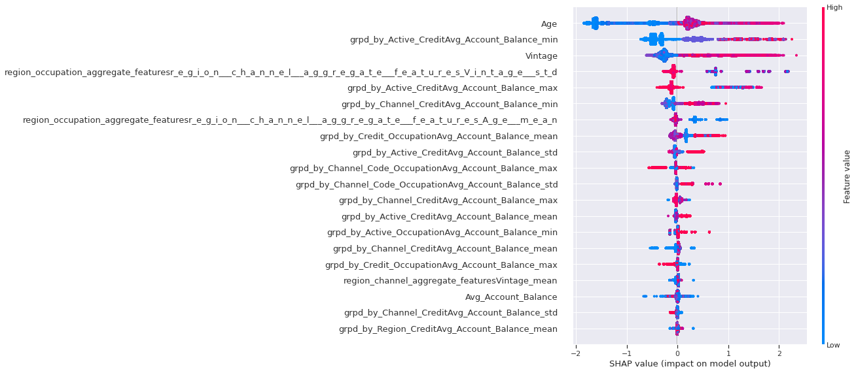
Models Used-CatBoost-SHAP values

Slide 13

Thank You

